Slide 1
The Evergreen Project
Be captivated by the experience.
Presented by: Cheyne Jackson

Slide 2
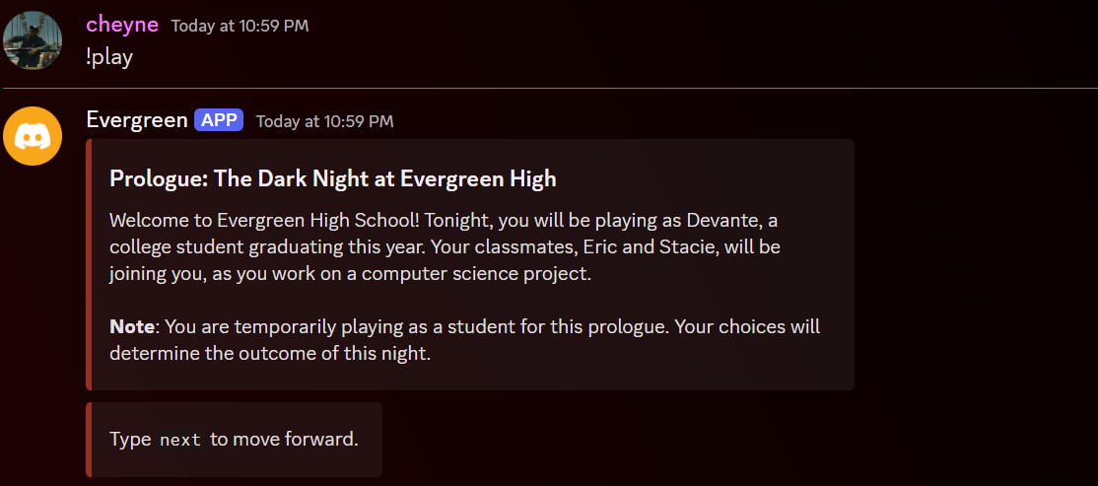
What is Evergreen?
A discord bot that simulates a thriller themed text-based adventure.
Players play as a student trying to save his life but will play as the detective solving the mystery in future chapters.

Slide 3
What source code/tutorials did you find?
01
02
03
04
Discord.py
https://github.com/Rapptz/discord.py
Setting up a Discord Bot
https://www.youtube.com/watch?v=F_TxtDxsFus&ab_channel=RichardSchwabe
Creating Discord Commands
https://www.youtube.com/watch?v=F_TxtDxsFus&ab_channel=RichardSchwabe
Pip Installation
https://pypi.org/project/discord.py/

Slide 4
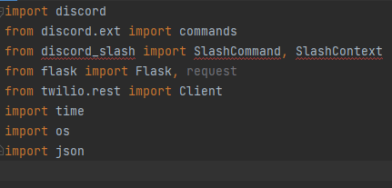
What roadblocks did you face?
Active Prologue Tracking
Discord Slash Commands
Creating the Storyline

Slide 5
What’s next?
Fixing Linear Progression
OpenAI
01
02
While choices affect gameplay, I want to make this effect more altering than it already is.
This wasn’t in my initial vision, but it could help smoothen the process.
Continuing the Storyline
More commands?
03
04
This was only the prologue, which revolved around three college students.
!save, !pause, etc

Slide 6
Final Thoughts

